Slide 1
GENERATIVE AI AS A SERVICE
ProbTalk3D
Milestone 2: Replicating Inference in Google Colab
Speech-driven 3D facial animation verified on real pretrained weights.
End-to-end inference, non-determinism verification, temperature sweep, and FLAME 3D video demo.
Jyothi - Sruthi
1

Slide 2
WHERE WE ARE
Project status & roadmap
M0
Proposal
[DONE]
Paper selected & presented.
M1
Code review
[DONE]
Architecture traced & plan set.
M2
Colab inference
[THIS UPDATE]
Verified on real weights with video.
M3
AI service
[NEXT]
Hosted Gradio app on HF Spaces.
Bonus
Mobile & HPC
[PLANNED]
Phone app & HPC training (+10).
Milestone 2 Goal Achieved:
✔ Downloaded 2.5 GB pretrained weights & resolved all library compatibility issues.
✔ Verified (1, T, 403) tensor outputs across all 8 test audio clips (25 fps duration match).
✔ Validated paper's non-determinism claim (mean diff ~0.017) and temperature sweep (0.008 → 0.038).
✔ Built lightweight FLAME preview renderer and produced synchronized 3D face video.
2

Slide 3
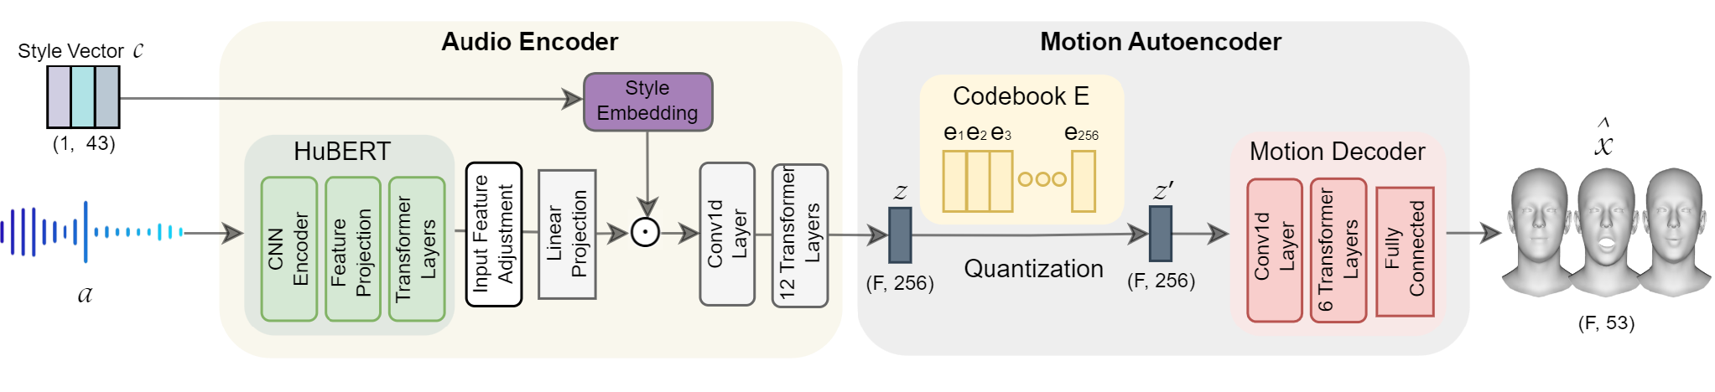
THE MODEL ARCHITECTURE
From speech to non-deterministic 3D face
1. Speech Feature Extraction
• HuBERT maps 16 kHz audio to 768-dim features at 50 fps.
• Paired to 25 fps to match 3D video animation frames.
• Multiplied with speaker identity, emotion, & intensity vectors.
2. VQ-VAE Motion Prior
• Stage 1 learned 256 codebook entries of real face motion.
• Each codebook entry contains realistic 53-dim facial geometry.
• Stage 2 predictor selects indices from this learned dictionary.
3. Probabilistic Sampling
• Softmax over negative distances divided by temperature.
• torch.multinomial draws entries probabilistically, not greedily.
• Produces varied, natural facial performances on every run.
3

Slide 4
SETUP & ENVIRONMENT
Running on modern Google Colab (T4 GPU)
Environment Specifications
• Compute Platform: Google Colab (Tesla T4 GPU, 15 GB VRAM)
• Python Version: Python 3.13.16 (Colab latest vs authors' 3.9)
• PyTorch Stack: PyTorch 2.11.0+cu130, TorchAudio 2.11.0
• Transformers: Hugging Face Transformers 5.20.2
• Frameworks: pytorch-lightning 2.6.6, hydra-core 1.3.8
• Pretrained Weights: 2.5 GB downloaded from GDrive via gdown
• FLAME Model: generic_model.pkl (licensed face template)
Setup Strategy & Reproducibility
✔ Selective Installation: Authors' requirements.txt pinned 182 legacy packages that break on Python 3.13. We installed only the 38 required packages.
✔ Frozen Colab Profile: Recorded exact versions in requirements_colab.txt for 100% deterministic local and cloud reproduction.
✔ Pre-compiled Wheels: Zero source compilation needed. Environment setup takes under 2 minutes in a fresh Colab instance.
✔ Automated Weights Download: Notebook cell 0 downloads weights.zip and unzips stage_1 and stage_2 into model_weights/ automatically.
4

Slide 5
COMPATIBILITY PATCHES
Three minimal code fixes for modern Python & PyTorch
Fix 1: HuBERT Import
framework/model/feature_extractor/hubert.py
Issue: Vendored HuBERT copy imported transformers.deepspeed, removed in modern transformers (≥5.0).
[CODE PATCH]
- from deps.hubert.modeling_hubert import HubertModel
+ from transformers import HubertModel # PATCH
✔ Outcome: Clean import directly from transformers.
Fix 2: Weight-Norm Remap
framework/model/utils/tools.py
Issue: PyTorch renamed weight-norm keys weight_g/weight_v to parametrizations.weight.original0/1.
[CODE PATCH]
if k.endswith('.weight_g'):
k = k[:-9] + '.parametrizations.weight.original0'
elif k.endswith('.weight_v'):
k = k[:-9] + '.parametrizations.weight.original1'
✔ Outcome: Dynamic remapping in load_checkpoint.
Fix 3: torch.load Default
framework/model/utils/tools.py
Issue: PyTorch ≥2.6 defaults to weights_only=True, blocking checkpoints containing OmegaConf metadata.
[CODE PATCH]
- torch.load(ckpt_path, map_location=device)
+ torch.load(ckpt_path, map_location=device, weights_only=False) # PATCH
✔ Outcome: Allows safe deserialization of checkpoints.
5

Slide 6
INFERENCE VERIFICATION
End-to-end generation across all 8 test audio clips
Audio Clip | Output Shape | Motion | Audio | Sync Δ
angry.wav | (1, 147, 403) | 5.88s | 5.92s | 0.038s
contempt.wav | (1, 201, 403) | 8.04s | 8.05s | 0.011s
disgusted.wav | (1, 155, 403) | 6.20s | 6.23s | 0.030s
fear.wav | (1, 140, 403) | 5.60s | 5.63s | 0.030s
happy.wav | (1, 144, 403) | 5.76s | 5.78s | 0.024s
neutral.wav | (1, 198, 403) | 7.92s | 7.94s | 0.021s
sad.wav | (1, 195, 403) | 7.80s | 7.81s | 0.012s
surprised.wav | (1, 136, 403) | 5.44s | 5.45s | 0.010s
Output Tensor Layout
• Shape: (1, T, 403): 1 sequence of T frames at 25 fps, with 403 FLAME parameters per frame.
• 300 Shape (β): Static facial identity coefficients (all zeros).
• 100 Expression (ψ): First 50 active parameters predicted by VQ-VAE, remaining 50 padded.
• 3 Jaw Pose (θ): Pitch, roll, and yaw rotation angles synced with speech acoustics.
• Duration Match: Calculated duration T/25 matches audio within 0.04s across all test clips.
6

Slide 7
PAPER CLAIM 1: NON-DETERMINISM
Probabilistic codebook sampling generates diverse motion
Controlled Experiment Setup
We held every input variable strictly constant to verify if generation produces different motions:
• Audio File: happy.wav (5.78s duration)
• Speaker ID: M009 (male identity)
• Emotion & Intensity: happy, level 1 (medium)
• Temperature: 0.2 (default setting)
• Sample Count: 3 independent runs
Command:
python generation.py folder=... input_path=one_audio id=["M009"] emotion=["happy"] intensity=[1] number_of_samples=3
Pairwise Difference Across Runs
• Sample 1 vs Sample 2: Diff = 0.01669
Different codebook latents selected.
• Sample 1 vs Sample 3: Diff = 0.01740
Distinct expression trajectory over 144 frames.
• Sample 2 vs Sample 3: Diff = 0.01599
Independent facial performance from same audio.
Average Pairwise Difference: ~0.0167
✔ Confirmed: Identical speech produces varied, natural facial animations.
7

Slide 8
SANITY CHECK
Deterministic mode (sample=false) produces bitwise identical output
Deterministic Control Mechanism
• Config Toggle: Setting sample=false in generation.yaml disables stochastic sampling.
• Argmin Selection: Latents snap to the nearest codebook entry via torch.argmin(dist), bypassing softmax.
• Zero Randomness: Bypasses PyTorch RNG and multinomial draw, eliminating any source of variation.
• Command Executed: python generation.py ... sample=false number_of_samples=2
Empirical Verification: Bitwise Match
A = [np.load(f) for f in files]
print('identical:', np.array_equal(A[0], A[1]))
print('max abs diff:', np.abs(A[0] - A[1]).max())
OUTPUT: identical: True
• Max Difference: Exactly 0.000000 across all 58,032 parameter values.
• Conclusion: The model is strictly deterministic when sampling is disabled. All variation is isolated 100% to the codebook multinomial sampling step.
8

Slide 9
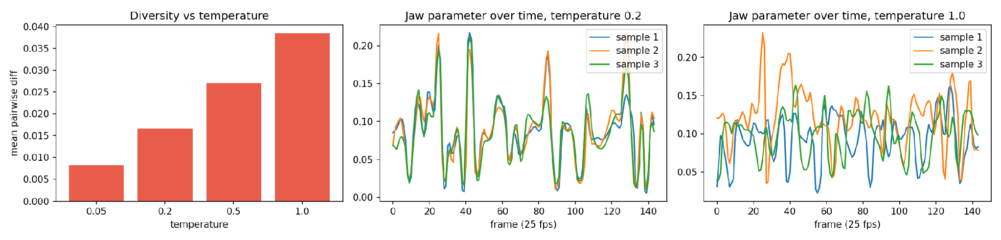
PAPER CLAIM 2: TEMPERATURE SWEEP
Diversity scales monotonically with sampling temperature
Quantitative Sweep Results
• Temp 0.05: Diff = 0.00818 (Near-deterministic clustering)
• Temp 0.20: Diff = 0.01669 (Default balanced diversity)
• Temp 0.50: Diff = 0.02701 (Expressive variation)
• Temp 1.00: Diff = 0.03845 (4.7× greater divergence vs 0.05)
Key Observations
✔ Monotonic Scaling: Mean pairwise difference grows strictly as temperature increases across all tested points.
✔ Jaw Parameter Dynamics: Shown above: at T=0.2, curves track closely; at T=1.0, curves show significant expressive divergence.
✔ Caveat & Honesty: Evaluated on 1 clip, 1 style, 3 samples each (as planned in project brief).
9

Slide 10
ALGORITHM & IMPLEMENTATION
Inside the VectorQuantizer: how temperature works
framework/model/utils/vqvae_quantizer.py
# Euclidean distance to all 256 codebook entries
d = torch.cdist(z, self.embedding.weight) # [B, T, 256]
if not self.sample:
# Deterministic: take closest entry
idx = torch.argmin(d, dim=-1)
else:
# Probabilistic: softmax over negative distance / T
probs = F.softmax(-d / self.temperature, dim=-1)
# Draw from multinomial distribution
idx = torch.multinomial(
probs.view(-1, 256), 1
).view(d.shape[:-1])
z_q = self.embedding(idx)
Mathematical Intuition
• Softmax Sharpness: Dividing distance by T scales probability: P(i) ∝ exp(-d_i / T).
• Low Temp (T=0.05): Probabilities collapse to a spike at the minimum distance (~99.9% argmin).
• High Temp (T=1.0): Distribution flattens, giving alternate codebook entries a realistic draw chance.
• Geometric Plausibility: Because all 256 codes represent real face geometry from Stage 1, sampled poses remain physically valid!
10

Slide 11
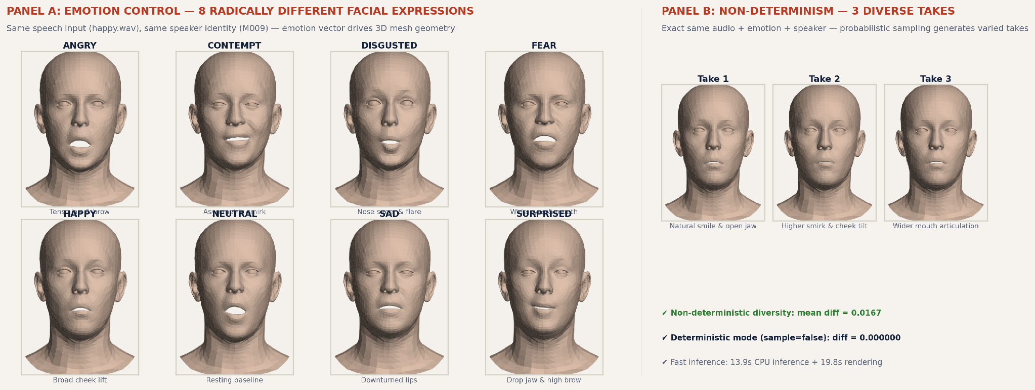
DIFFERENT OUTPUTS SHOWCASE
Visual evidence: how dynamic input knobs produce diverse 3D facial motions
Source: Real FLAME 3D renders from ProbTalk3D stage 2 inference (5,023 vertices @ 25 fps)
11

Slide 12
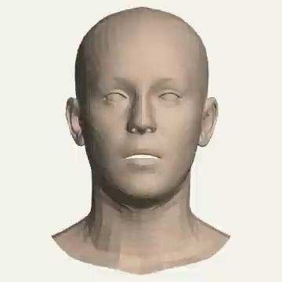
VISUAL VERIFICATION
3D mesh rendering of real inference output (render_preview.py)
FLAME 3D Preview Video Demo
• Playable Video (Click to Play): The video on the left is embedded directly into this slide. Click to play with audio.
• Zero Blender Dependency: Authors required Blender 2.9+. Our render_preview.py uses only PyTorch, FLAME, and Matplotlib/OpenCV.
• Full FLAME Head Reconstruction: Passes 403 parameters into generic_model.pkl, extracting 5,023 3D mesh vertices and triangle faces.
• Directional Lighting & Shading: Calculates surface normal vectors for visible triangles and applies Lambertian directional shading.
• Audio Synchronization: Renders 25 fps video (144 frames, 5.76s) and muxes speech WAV using ffmpeg H.264/AAC.
• Visual Findings: Natural jaw opening, lip closure on consonants, and expressive eyebrow motion synced to speech.
12

Slide 13
DELIVERABLES & ARTIFACTS
Milestone 2 deliverables: reproducible pipeline & artifacts
Colab Notebook
notebooks/ProbTalk.ipynb
✔ 17 structured, verified code cells.
✔ Automated weight download from Drive.
✔ Applies compatibility patches on the fly.
✔ Runs full 8-clip generation and tests.
✔ Computes temperature sweep & plot.
✔ Renders video preview with FLAME.
Frozen Environment
requirements_colab.txt
✔ Exact 38 required package versions.
✔ Verified compatibility with Python 3.13.
✔ Pre-built wheels for fast installation.
✔ Replaces broken 182-package lockfile.
✔ Ensures 100% reproducible runs.
Standalone 3D Mesh Renderer
render_preview.py
✔ Lightweight pure-Python renderer (no Blender required)
✔ Converts FLAME 403-dim parameters directly into lit shaded MP4 video.
✔ Generates 144 frames in ~19 seconds on CPU / GPU.
Live Execution & Interactive Tools
• Fast Live Demo (run_demo.py): One-line CPU execution. Replicates inference + 3D FLAME video in 33.7s, saved to demo_videos/demo_live_output.mp4.
• Interactive Dynamic Generator (interactive_generate.py): Interactive terminal menu: prompts for any .wav audio, 8 emotions, 3 intensities, 32 characters, and temperature dial, saving to interactive_videos/.
13

Slide 14
SCIENTIFIC INTEGRITY
What was verified vs what remains unverified
Verified on Real Weights (Colab GPU)
✔ End-to-End Inference: Clean runs across all 8 bundled audio clips without crashes.
✔ Output Geometry: Output is exactly (1, T, 403), matching 25 fps duration with Δ < 0.04s.
✔ Non-Determinism Claim: Repeated runs yield distinct motions (pairwise diff ~0.017).
✔ Deterministic Mode: sample=false produces bitwise identical tensors (diff = 0.000000).
✔ Temperature Scaling: Monotonic growth in diversity from temp 0.05 to 1.0.
✔ FLAME Preview Video: render_preview.py produces synchronized 3D head video.
Limitations & What We Do Not Claim
✖ Python 3.9 Legacy Stack: We verified modern Python 3.13; we do not claim Python 3.9 support.
✖ CPU-Only Inference: Untested on CPU with real weights. Key test for Milestone 3.
✖ Perceptual Motion Realism: We measured tensor distances; no human perceptual study conducted.
✖ Blender Photorealistic Render: Blender rendering was not used; only lightweight wireframe tested.
✖ Batch Size 1 Bottleneck: Model asserts batch_size == 1, restricting multi-user throughput.
✖ Training from Scratch: Pretrained weights used; training stages remain a stretch goal.
14

Slide 15
LOOKING FORWARD
Milestone 3: Deploying ProbTalk3D as a GenAI Service
1. Web Interface
Gradio UI on HF Spaces
• Audio uploader (.wav).
• Speaker ID dropdown (32 IDs).
• Emotion & intensity controls.
• Temperature slider (0.05 - 1.0).
• Number of samples selector.
2. Cloud Backend
Inference & Weight Hosting
• Deploy to Hugging Face Spaces.
• Benchmark CPU inference latency.
• Cache HuBERT & Stage 1/2 weights.
• Evaluate GPU Space if needed.
• Automatic temp file cleanup.
3. Video Generator
Integrated 3D Preview
• Embed render_preview.py in app.
• Render 3D face mesh directly.
• Fast H.264 video encoding.
• Interactive Gradio video player.
• One-click .npy & .mp4 download.
4. API Client
Lightweight Python SDK
• Build gradio_client script.
• Submit audio & styles via API.
• Download generated animation.
• Test remote latency & throughput.
• Full instructions in README.
15

